Slide 2
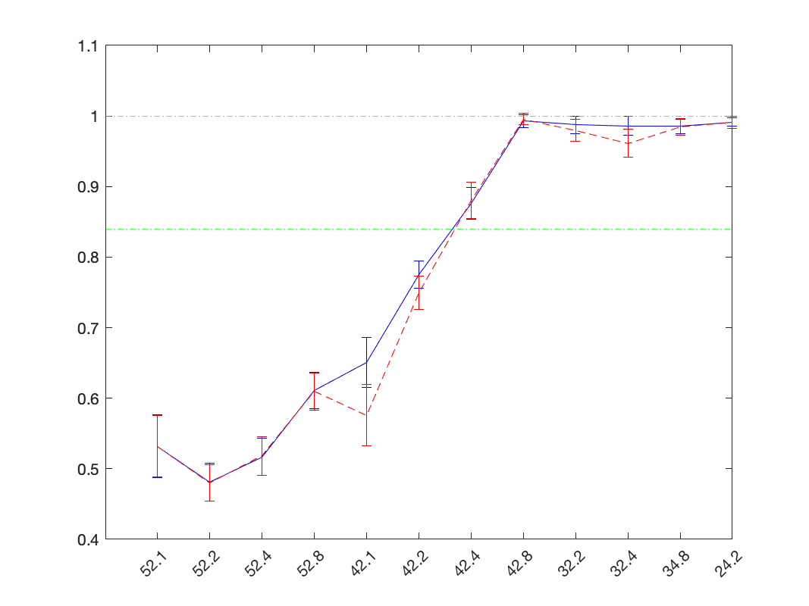
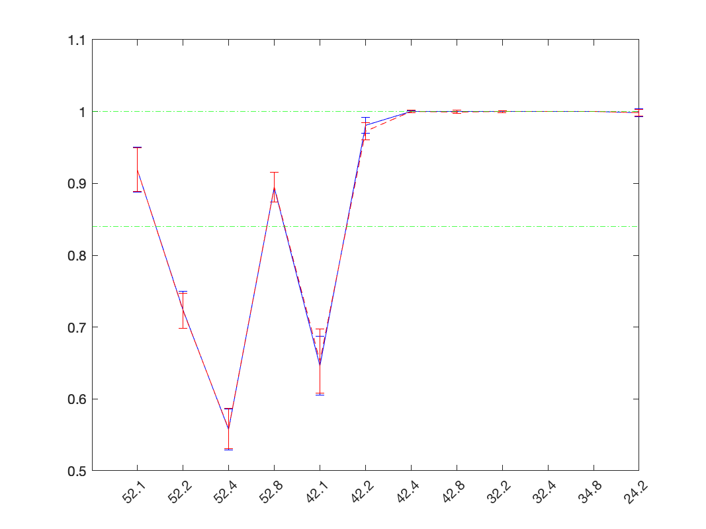
2AFC: probing sensitivity
stim: dim flash
ds cell spike_time → 20ms bins
select random flash trial (r_{f}) & random null trial (r₀)
null trial = spontaneous activity before / before & after flashes
calculate discriminant
D = mean(r_{other_flash}) – mean(r_{other_null})
correct if r_{f} · D > r₀ · D
plot probability correct vs flash intensity
convert x axis to log(intensity) (R*/rod)
recheck code. recheck cell quality in notebook.
sanity check using xiaoyang’s data?

